Slide 1

PROJECT PROPOSAL
AI Diagnostic System
Prepares by: Rania Mukahal
Prepare For: Al Haramain Hospital and its subsidiary Salma Medical Center

Slide 2

Introduction
This project aims to enhance the operational and diagnostic capabilities of Al Haramain Hospital and Salma Medical Center. The purpose of this project is to improve the quality of patient care.

Slide 3

CHALLENGES
Diagnostic inaccuracies
Delays in the diagnostic process
Repetitive manual tasks
Operational inefficiencies
Stakeholder Resistance
Security Concerns

Slide 4

FINDINGS
Expressed how AI could reduce human errors
67%
Highlighted diagnosis issues
80%
Showed that repetitive manual tasks are a source of burnout
66.7%

Slide 5
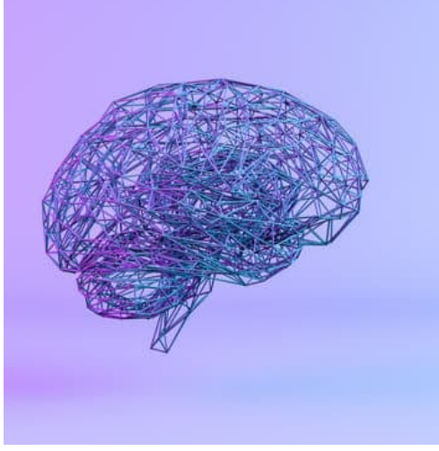
Proposed Solution
An AI diagnostic system that aims to improve patient outcomes by providing accurate diagnosis, and evidence-based recommendations, and reducing human errors and delays. Automating routine tasks will allow medical professionals to focus on patient care and outcomes. The hospital would benefit as its reputation will effectively increase as optimized outcomes and operational efficiency will help build trust with different patients and stakeholders. These impacts align with the organization’s objectives and goals to provide high-quality healthcare and ensure better patient outcomes.

Slide 6
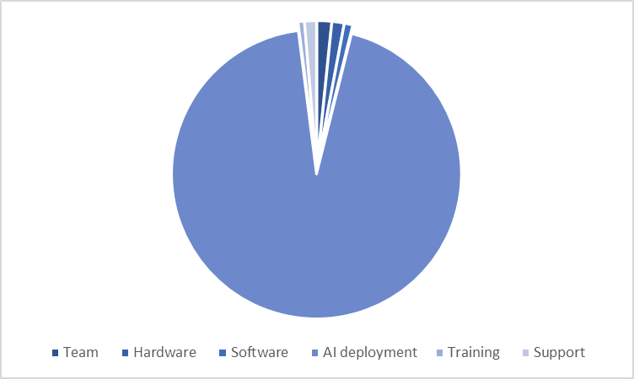
Financial Analysis
Team | $127,248
Hardware | $106,020
Software | $74,000
AI deployment | $7,425,000
Training | $53,800
Support | $105,100

Slide 7
Project Timeline
4/1
6/1
3/2
18/2
1/3
Project
initiation and communication with stakeholders
The establisment of data centers
Prototype Delivery and feedback
Integration and Testing
Final Review and feedback

Slide 8

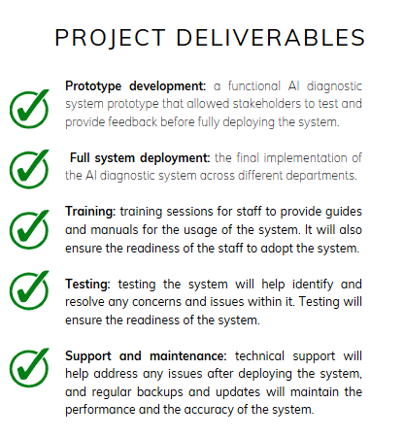



Slide 9
This project aims to address the needs of Al Haramain Hospital and Salma Medical Center by enhancing diagnostic accuracy, operational efficiency, and patient outcomes.
Summary

Slide 10
STAY SAFE
THANK YOU

